Slide 1
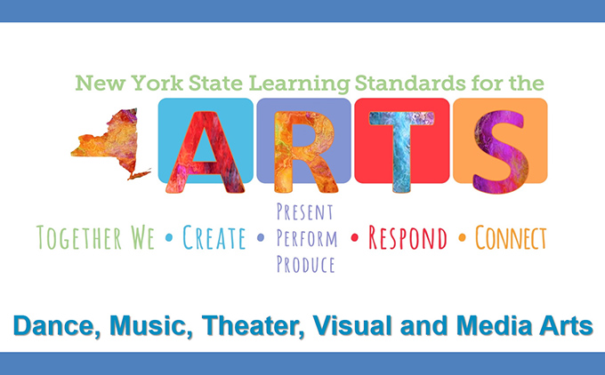
January 28,2019
Kathy Pilling-Whitney

Slide 2
AM: Standards and curriculum: Rationale
Through creating, performing, responding, and connecting in the arts, students generate experiences, construct knowledge, and build a more integrated understanding of self and community. They explore and express ideas, feelings, and beliefs about the past and present; discover new ideas; and begin to envision possible futures. Through careful study of their own and others’ art, students explore and make sense of the broad human condition across time and cultures.

Slide 4
Artistic Processes
Cr- Creating : Conceiving and developing new artistic ideas and work
Pr- Performing, Presenting, Producing: Realizing artistic ideas and work through interpretation, Interpreting and sharing artistic work, realizing and presenting artistic ideas and work
Re- Responding: Understanding and evaluating how the arts convey meaning
Cn- Connecting: Relating artistic ideas and work with personal meaning and external context

Slide 5
A map for how to proceed in a confident way
When moving forward in CURRICULUM DEVELOPMENT:
-Identify enduring ideas, key concepts, and/or essential questions.
-Articulate what would be acceptable evidence that students understand and are able to perform (assessment)
-Design instructional strategies to move students toward desired ends.

Slide 6
Enduring Understandings and Essential Questions:
Enduring Understanding: Creativity and innovative thinking are essential skills that can be developed
Essential Questions:
1. What conditions, attitudes and behaviors support creative risk taking and innovative thinking?
2. How does collaboration expand the creative process?

Slide 7
What conditions, attitudes and behaviors support creativity and innovative thinking?
Conditions | Attitudes | Behaviors
materials | Positive mindset | patience
tools | Open mind | concentration
props | comfortable | planning
furniture | balance | determination
resources | collaboration | commitment
teacher | cooperation | active

Slide 8
Enduring Understanding: Creativity and innovative thinking are essential life skills that can be developed.
Essential questions:
What conditions, attitudes and behaviors support creative risk taking and innovative thinking? See Sample
How does collaboration expand the creative process?
Grade: ___7_____: Question or artistic problem to be solved (see chart by grade level)
_What strategies can I apply to my work to overcome creative blocks?_______________
Possible outcomes or student projects:
___mind map- identity, brainstorming, research, looking at other artist’s work, looking at each other’s work, mid project critique and/ or gallery walk, talk about the process___________________________________________________

Slide 9
Brainstorm by grade level
Using your lesson plans and the worksheets on the Enduring understandings and the essential questions, brainstorm by grade levels to come up with a variety of ideas on how to implement the higher level thinking involved with these essential questions… Please try to get through all 11 Standards using the worksheets- if we don’t have time to do that, we may finish that this afternoon…
We will take a break at 10:00, come back together by 10:20
Share session

Slide 10
PM Differentiation

Slide 12
Choice Theory/ portfolios

Slide 13
Problems
Discussion by Grade level
Ideas that may have come up from this mornings lesson plan sharing in small groups

Slide 14
Solutions
Wish list
Adaptive material ideas

Slide 15
Gifted/ advanced program in Art
“It is almost impossible to prepare teacher candidates for everything they will encounter”
“Gifted education leaders should also widely acknowledge the arts as an area of giftedness.”
HAVA- high ability visual artist
-Jennifer Fisher

Slide 16
Joseph Renzulli:

Slide 17
Model Program for gifted art students: What would be different?

Slide 18
Scheduling for optimal time blocks- homeroom, 1st per.
Matting, framing, portfolio preparation and presentation
Better individual records: separate records of student work for IEP’s, assignments, changes, results, evaluations
College visitation- going to and meeting representatives from colleges
Visiting artists- arts council, directories
Art Shows: documentation, presentation issues, themes, signs, label assignments, matting
Scholastic Art awards
ARTS- Arts recognition and talent search- Princeton
AP, ACE
Art Club
School paper
Summer programs

Slide 19
Art Show and Open House- year end
Use of showcases and display areas in the building
Display at Board offices, Banks, City Hall
Personal Exhibits: featured artist, artist of the month
Career planning
Sale of work
Moveable display panels
Creation of new courses, or personalized topics within a course, independent study
Weekend Art retreat (hah!)
Keep records of materials and books borrowed

Slide 20
High School- new NYS Standards: 3 levels
Proficient
Accomplished
Advanced

Slide 21
Artist of the Month

Slide 22
NYSATA Portfolio Requirements Commencement Level: General Education Required Artworks (7 selections)
Artwork 1- Self Portrait | Work reveals a command of symbol or likeness as well as expression or mood. Work reveals problem solving ability. | Work may be 2-D or 3-D in any medium. Student should reveal an understanding of the of the characteristics and use of the specific medium selected.
Artwork 2- Observation/Perception- Piece should be based on observations and knowledge of vantage point, perspective and point of view. | Work demonstrates observation and perception of the subject. Work demonstrates creative interpretation. | Work may be 2-D or 3-D in any medium. Student should reveal an understanding of the characteristics and use of the specific medium selected.
Artwork 3- Psychological-Communication/Message- Student should select a piece that conveys a strong message, idea, or emotion. | Work should demonstrate knowledge of the elements and principles to convey a specific meaning. Work clearly conveys a strong meaning or emotion. Work displays emotional impact. | Work may be 2-D or 3-D in any medium. Student should reveal an understanding of the characteristics of the media selected to convey meaning.
Artwork 4- Cultural Awareness Student should choose a work that has a clear connection to cultural or historical context or explores social, historical/contemporary, and/or political issues. | Work should communicate awareness of cultural diversity. Work should reflect social, historical or political themes. | Work may be 2-D or 3-D in any medium. Student should reveal an understanding of the characteristics and use of the specific media selected to convey theme.
Artwork 5- Process Piece- Artwork plus pre-sketches, visual references, sketchbooks, journal, etc. | Work should demonstrate the development of the artwork from ideas, to final piece. Problem-solving skills should be evident in process trail. | Work may be 2-D or 3-D in any medium. Student should reveal an understanding of the characteristics and use of the specific media selected and how they influence artistic decision making.

Slide 23
The Artist’s Statement, along with the portfolio using:
Notes
Surveys for pulling out ideas
Graphic organizers

Slide 24
Portfolio Assessment: Creativity and innovative thinking are essential skills that can be developed :
Creativity and innovative thinking
Craftsmanship (ability)
Commitment (getting the work done)

Slide 25
Sources:
Clark, Gilbert and Enid Zimmerman. Teaching Talented Art Students: Principles and Practice. Columbia University Teachers College and NAEA, Reston, VA. 2004.
Fisher, Jennifer. “They Didn’t Teach Us How”: Teaching High-Ability Students in a Secondary Setting. NAEA Art Education. January, 2019. Volume 72, No. 1, pgs. 28-34.
Hurwitz, Al. The Gifted and Talented in Art: A Guide to Program Planning. Davis Publications. Worcester Mass. 1983.
Renzulli, Joseph. “The Three Ring Conception of Giftedness: A Developmental Model for Promoting Creative Productivity”. Univ. of Conn. https://pdfs.semanticscholar.org
https://nysata.org/portfolio-project
www.nysed.gov/curriculum-instruction/arts

